Slide 1
Data Structures and Algorithms (CCE 221)
By
Dr : Asmaa Aly Hagar

Slide 2
Lecture1

Slide 3
Contents of the Lecture
Course Plan
Introduction to data structures
Mathematics Review
Review of Concepts of ‘C++’

Slide 4
Course Plan

Slide 5
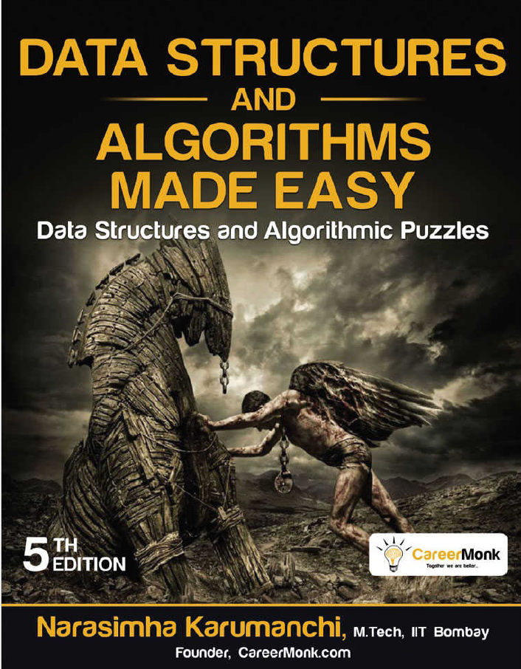
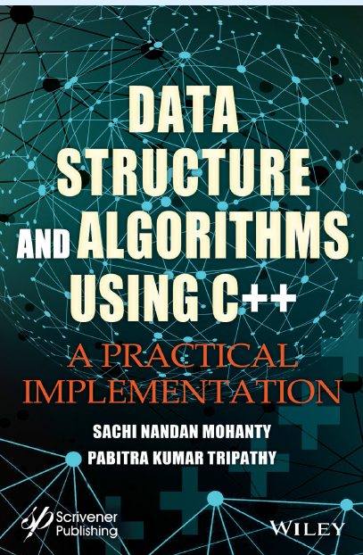
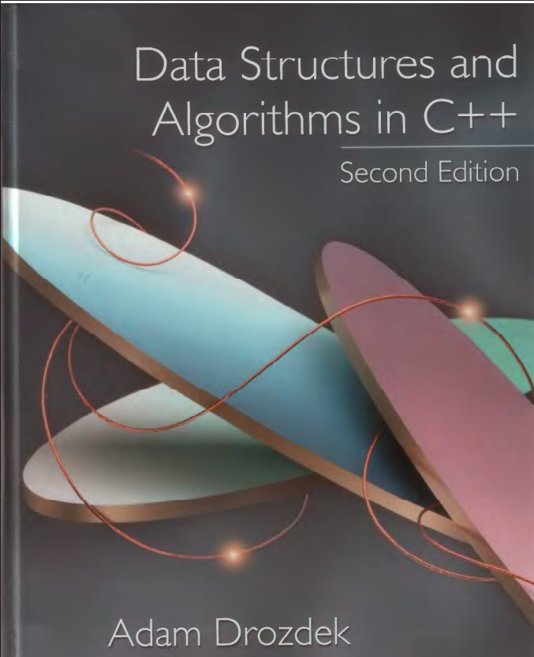
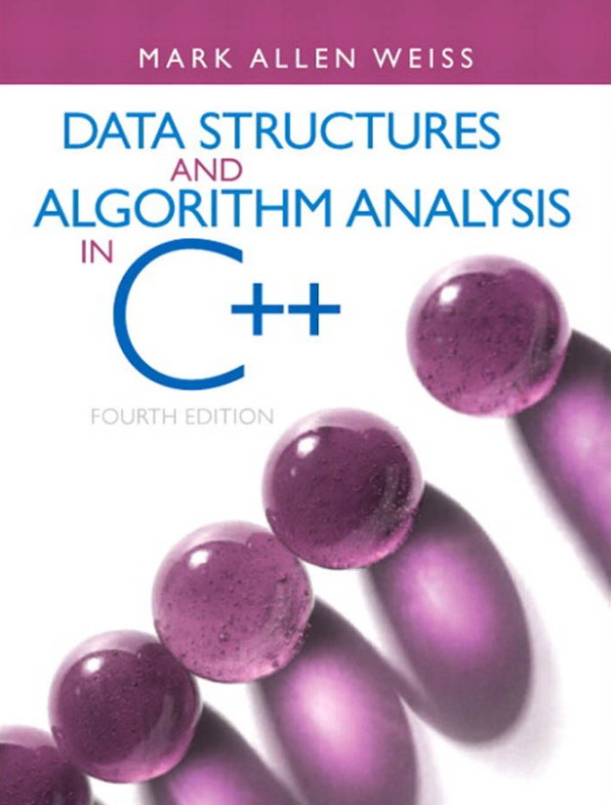
Textbooks

Slide 6
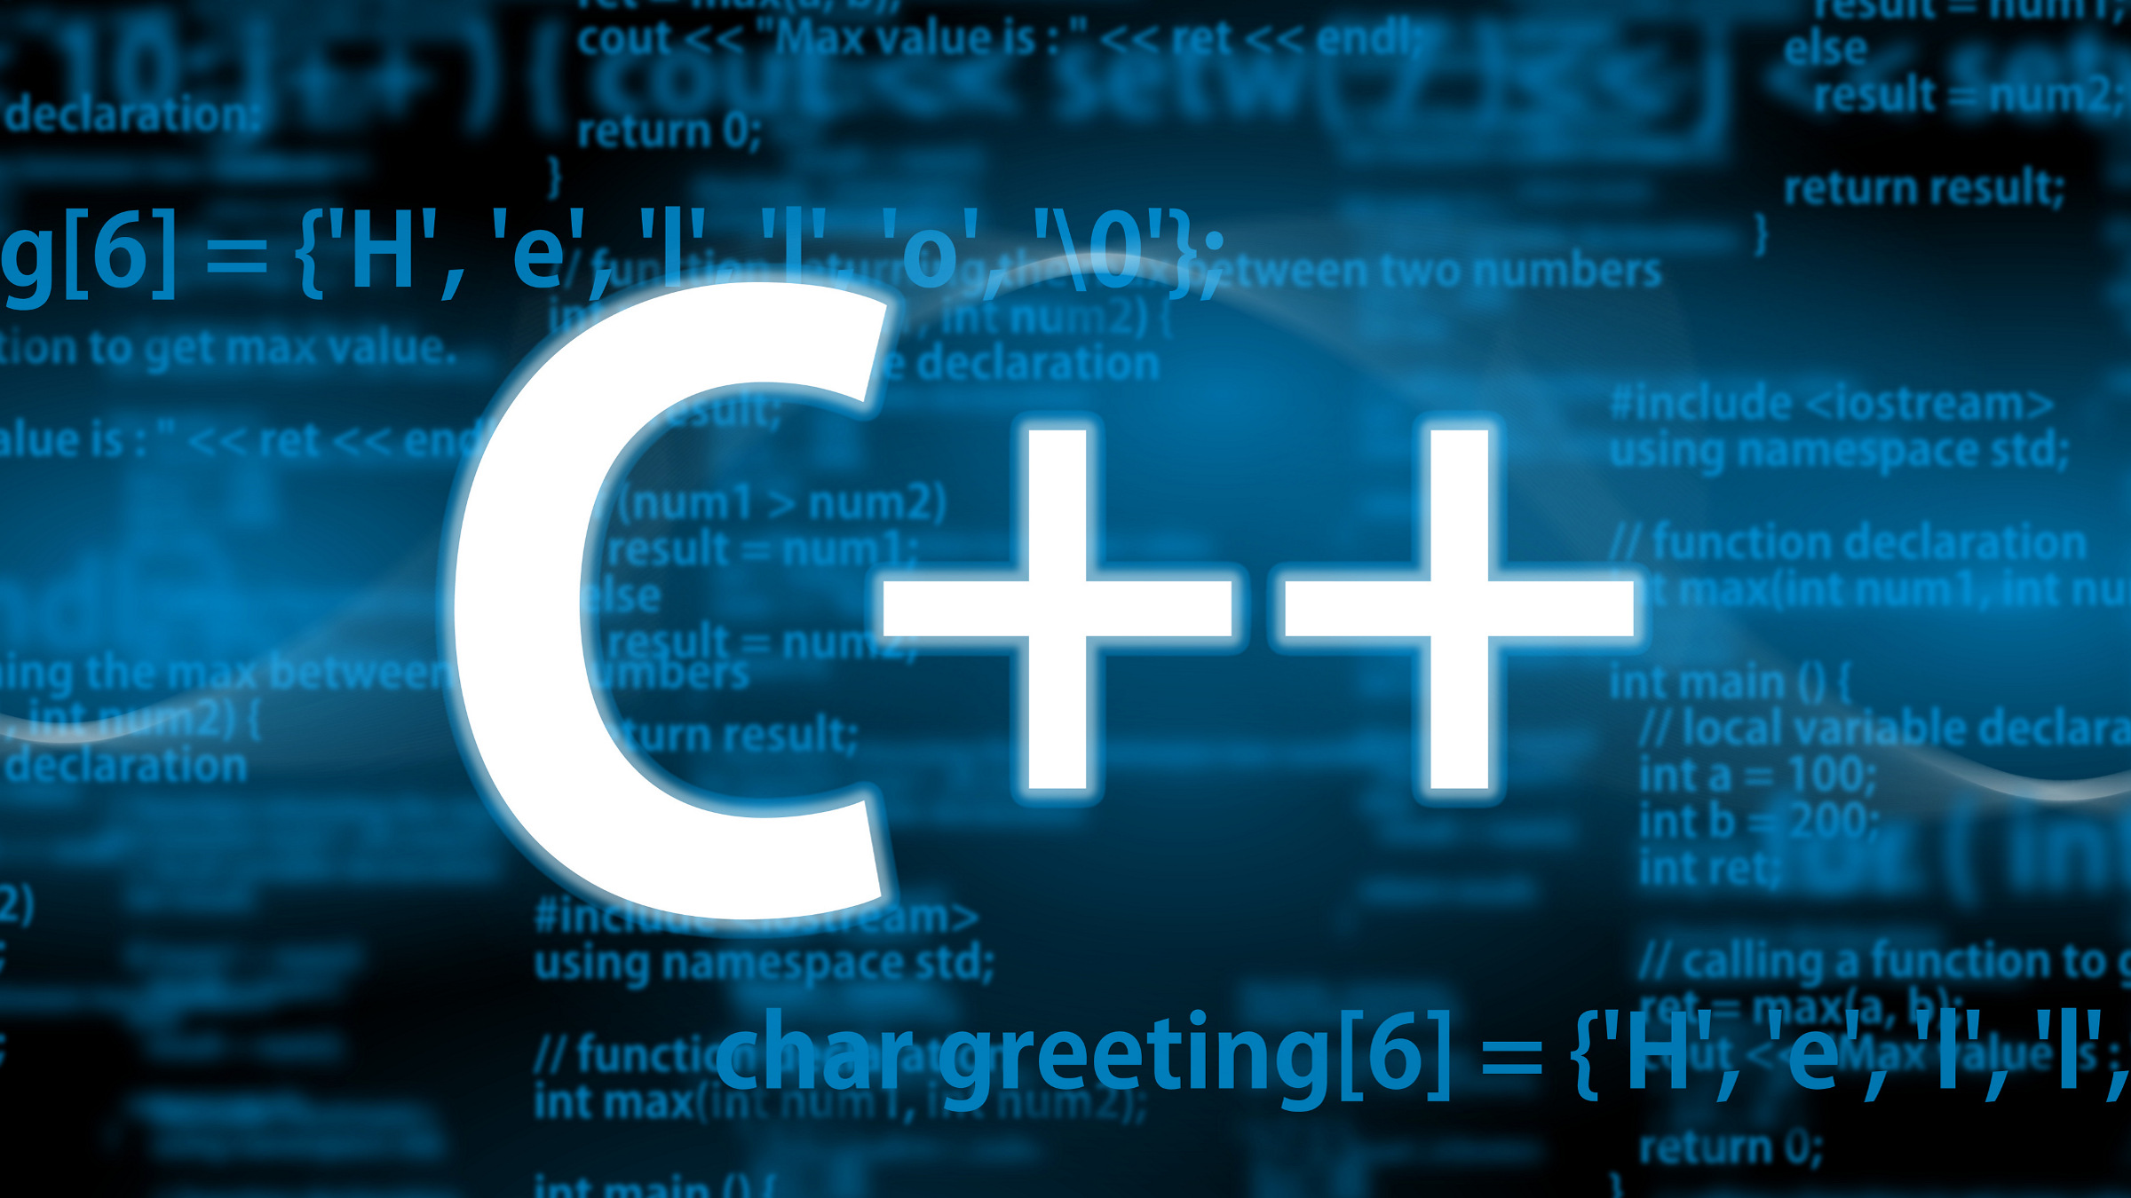
Programming Language
Advantages of using C++
Speed and Efficiency:
C++ is a compiled language that allows for low-level memory manipulation and optimized code execution, resulting in faster and more efficient algorithms.
Object-Oriented Programming:
C++ supports object-oriented programming paradigms, making it easier to organize and structure code.
Standard Template Library:
C++ provides a vast library of pre-implemented data structures and algorithms that can be used.
Notes:
Performance and Efficiency:
C++ provides low-level memory management capabilities and direct hardware access, leading to highly optimized and efficient data structure implementations. This is crucial for applications where performance is critical.
Object-Oriented Programming (OOP) Features:
C++ supports OOP principles like classes, encapsulation, inheritance, and polymorphism. This allows for the creation of well-structured, modular, and reusable data structure implementations, making code more maintainable and scalable.
Standard Template Library (STL):
The C++ STL offers a rich collection of pre-implemented data structures (like vector, list, map, set, queue, stack) and algorithms. This significantly speeds up development and provides robust, tested implementations of common data structures.
Memory Management Control:
C++ allows for explicit memory management using new and delete, which provides fine-grained control over memory allocation and deallocation. This is beneficial for optimizing memory usage in data structures.
Competitive Programming and System Programming:
C++ is widely used in competitive programming due to its speed and the STL. Its low-level capabilities also make it suitable for system-level programming and embedded systems where resource management is paramount.
Portability:
C++ is a highly portable language, allowing data structure implementations to run across various operating systems and platforms with minimal modifications.

Slide 7
Course Contents
Introduction to Data Structures + Mathematics Review + Review of Concepts of ‘C++’
Sparse Matrix, Concepts of Class, and Analysis of Algorithms
Linked Lists
Stack
Queue
Trees
AVL Trees
Priority Queues and Heaps
Graph
Searching and Sorting
Hashing

Slide 8
Course Academic Calendar
Week Num | Date | Content
Week1 | 25/9/2025 | Introduction to Data Structures + Mathematics Review + Review of Concepts of ‘C++’
Week2 | 02/10/2025 | Sparse Matrix, Concepts of Class, and Analysis of Algorithms
Week3 | 09/10/2025 | Linked Lists
Week4 | 16/10/2025 | Stack
Week5 | 23/10/2025 | Queue
Week6 | 16/10/2025 | Trees
Week7 | 30/10/2025 | Midterm
Week8 | 06/11/2025 | AVL Trees
Week9 | 13/11/2025 | Priority Queues and Heaps
Week10 | 20/11/2025 | Graph
Week11 | 27/11/2025 | Searching and Sorting
Week12 | 04/12/2025 | Hashing

Slide 9

Grades distribution
Total: 100
Final Written Exam: 40
Midterm Written Exam: 15
Section: 10
Quizzes: 5
Project: 10
Oral/Lab: 10
Reports 10

Slide 10
Course Academic Calendar
Week Num | Date | Content
Week1 | 24/9/2025 | Introduction to Data Structures + Mathematics Review + Review of Concepts of ‘C++’
Week2 | 01/10/2025 | Sparse Matrix, Concepts of Class, and Analysis of Algorithms
Week3 | 08/10/2025 | Linked Lists
Week4 | 15/10/2025 | Stack
Week5 | 22/10/2025 | Queue
Week6 | 15/10/2025 | Trees
Week7 | 29/10/2025 | Midterm
Week8 | 05/11/2025 | AVL Trees
Week9 | 12/11/2025 | Priority Queues and Heaps
Week10 | 19/11/2025 | Graph
Week11 | 26/11/2025 | Searching and Sorting
Week12 | 03/12/2025 | Hashing

Slide 11
Introduction to data structures

Slide 12

Data Structures
Data structure is the representation of the logical relationship existing between individual elements of data.
Data structure is a way of organizing all data items that considers not only the elements stored but also, their relationship to each other.
Data structure is a data organization, management, and storage format that enables efficient access and modification.

Slide 13

The Need of Data Structures
Helps to understand relationship one data element with other and organize it within the memory.
Examples:
Months of a year: one month after the other can be linked. Thus, knowing the starting and ending month name could help to know the other months.
Specific department of a university can be represented in a tree.
Example: IT

Slide 14

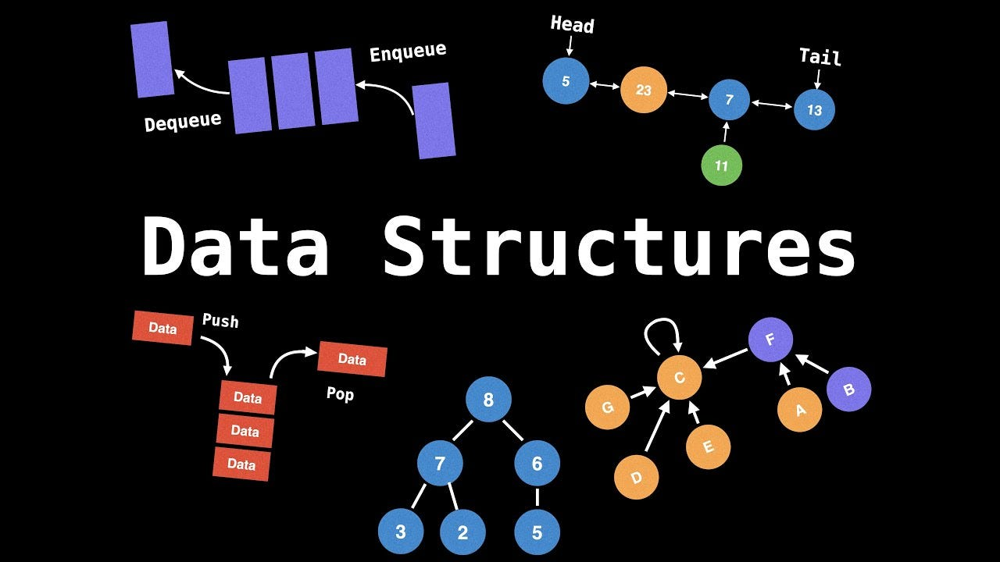
The Need of Data Structures
The selection of good data structure will help the programmer to design more efficient programs.
The efficiency of the program depends on two measurements :
Space complexity
Time complexity

Slide 15
Data Structures and Algorithms
Data structure specifies
Organization of data
Accessing methods
Degree of associativity
Processing alternatives for information
The step-by-step procedure to solve a problem is known as the ALGORITHM.
Program is the implementation of an algorithm in some programming language.
In mathematically, Algorithm + Data Structure = Program

Slide 16
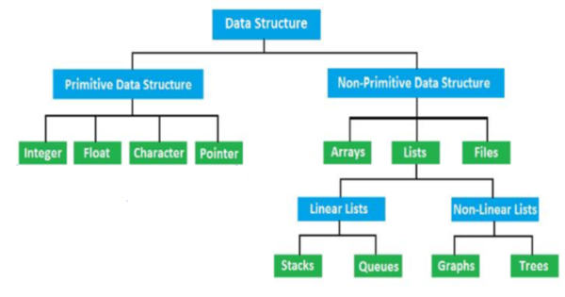
Types Data Structures
Primitive Data Structures
These data types are predefined (built-in) in the C programming language. They store the data of only one type.
Non-Primitive Data Structure
They can store data of more than one type. They are derived from the primitive data types and are called derived data types or user-defined data types.

Slide 17
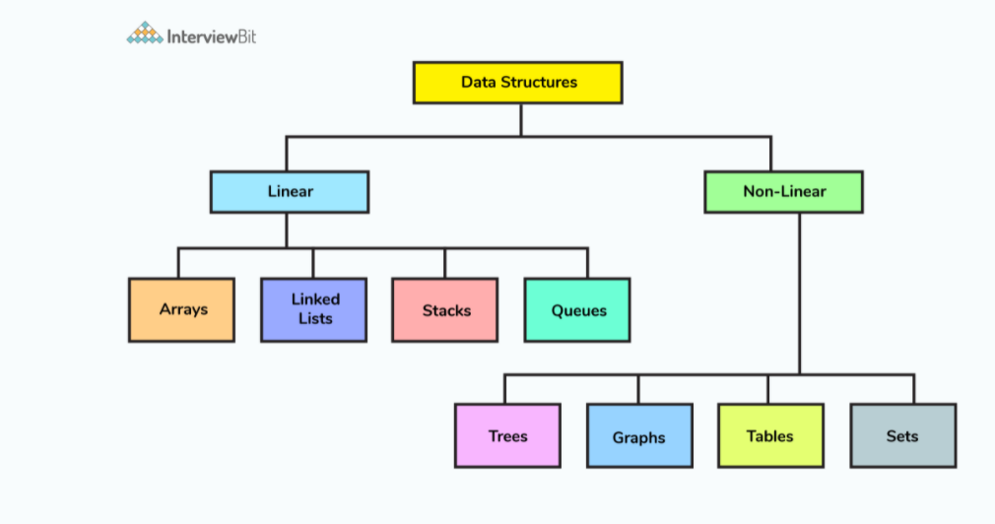
Types Data Structures
Linear Data Structures
The data in this data structure is arranged in a sequence, one after the other i.e. each element appears to be connected linearly.
Non-Linear Data Structure
The elements in this data structure are not arranged sequentially. They form a hierarchy i.e. the data elements have multiple ways to connect to other elements.

Slide 18
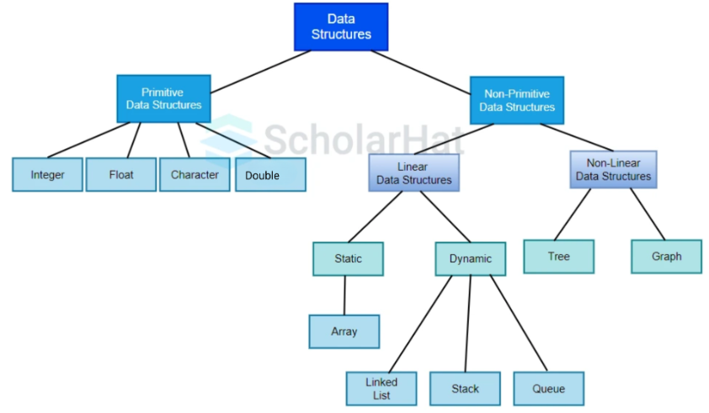
Types Data Structures
Static Data Structures
They have a fixed size. The memory is allocated at the compile time, and the user cannot change its size after being compiled; however, the data can be modified.
Dynamic Data Structure
They don't have a fixed size. The memory is allocated at the run time, and its size varies during the program execution. Moreover, the user can modify the size as well as the data elements stored at the run time.

Slide 19
Operations Performed in Data Structure
Traversing
Insertion
Deletion
Merging
Sorting
Searching

Slide 20

Array
Array is one of the most familiar non-primitive linear data structure.
It is a collection of items –which are of the same type- stored contiguously in the memory.
We used to deal with the Array without thinking about its details.

Slide 21
Array
The c statement: int A[10];
means:
reserving a contiguous space in memory, so that: memory size = element size * number of elements
giving the starting address the name A
The c statement : A[3] = 27;
means:
calculates the location address:
Loc address = A+3* sizeof(int)
stores 27 in that location.
Array is an Abstract Data Type

Slide 22
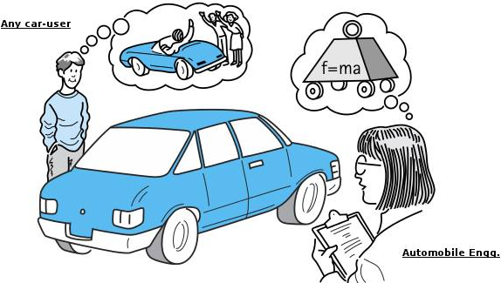
Abstraction
Considering the high-level characteristics without getting bogged down in the details.

Slide 23
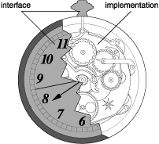
Data abstraction
The process of providing only the essentials and hiding the details is known as abstraction.
It is called "abstract" because it provides an implementation-independent view.
Data abstraction allows us to use a data structure without considering how it is implemented.

Slide 24
Abstract Data Type
Abstract Data Type (ADT):
Is an organized data object and a set of operations for manipulating it
ADT = Organized data + Operations
An Abstract Data Type (ADT) is a conceptual model that defines a set of operations and behaviors for a data structure, without specifying how these operations are implemented or how data is organized in memory.
It does not specify how data will be organized in memory and what algorithms will be used for implementing the operations.
Example: in C, to implement integer data type, INTEGER_ADT defines:
Range of numbers that will be represented
Formats for storing the integer numbers
Operations on it, such as addition, subtraction, division, multiplication, modulo

Slide 25
Mathematics Review

Slide 26
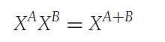
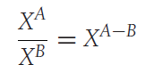
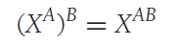
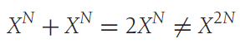
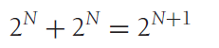
Exponents

Slide 27
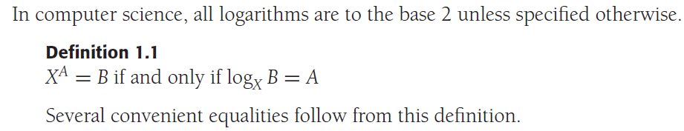
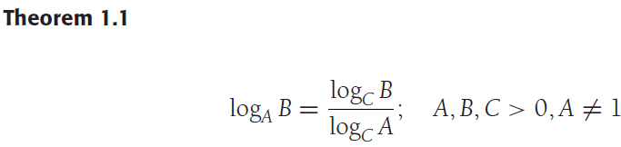
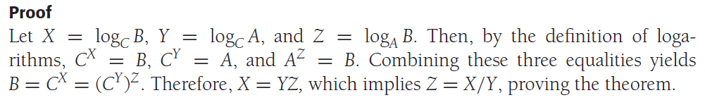
Logarithms

Slide 28
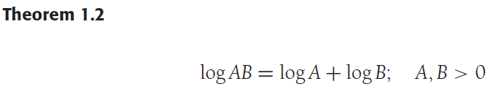
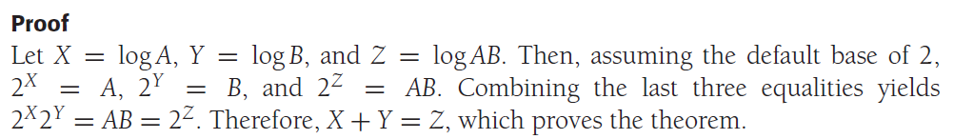
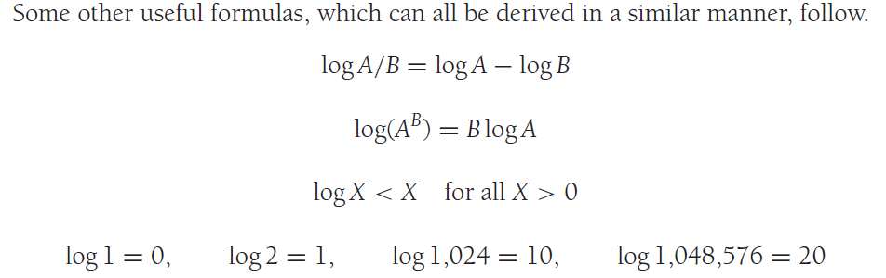
Logarithms

Slide 29
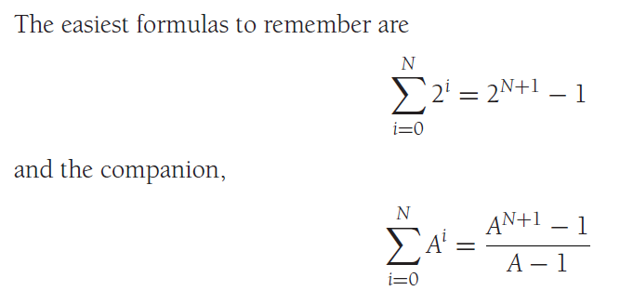
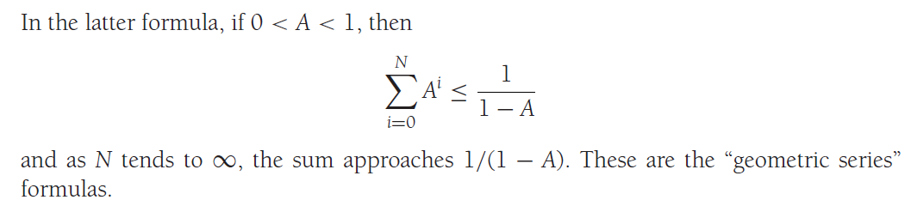
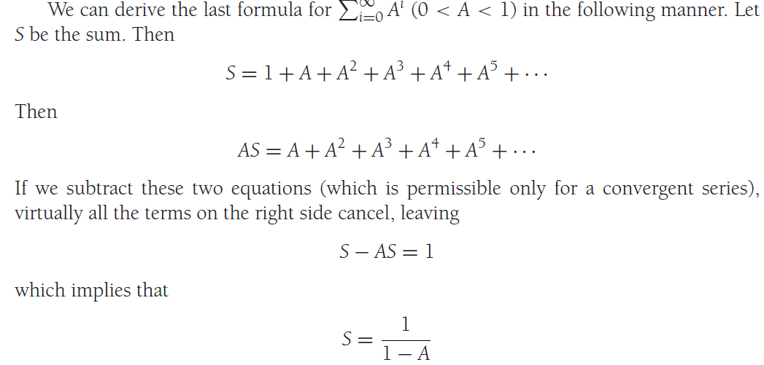
Series

Slide 30
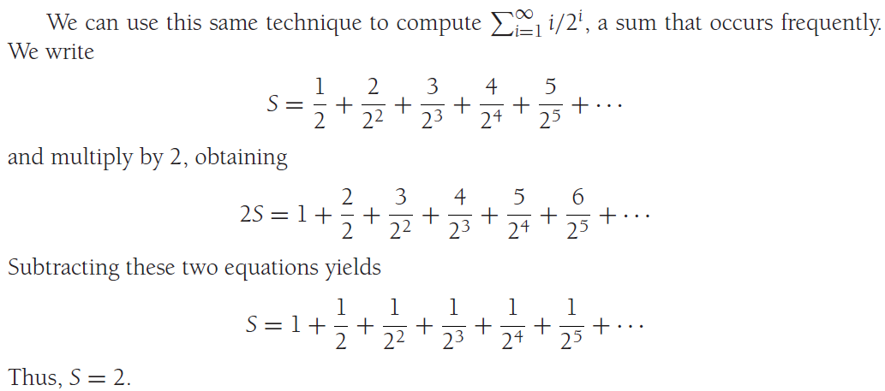
Series

Slide 31
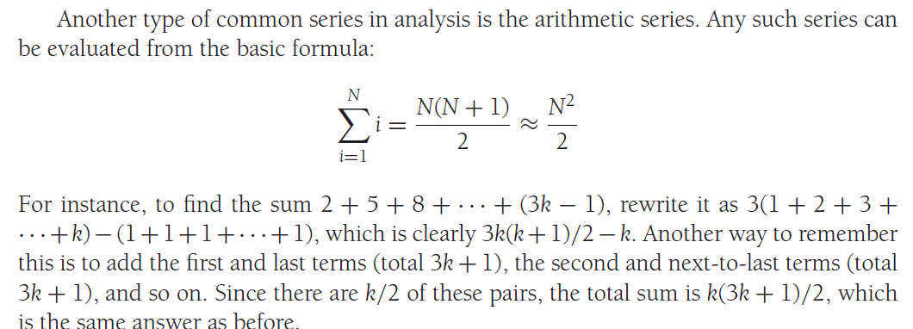
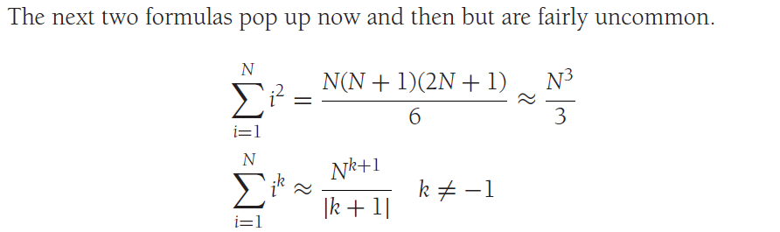
Series

Slide 32
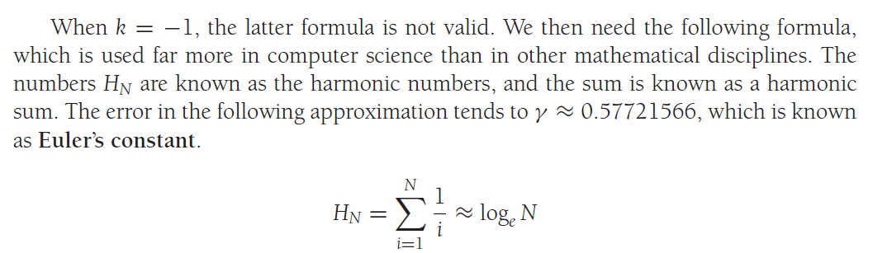
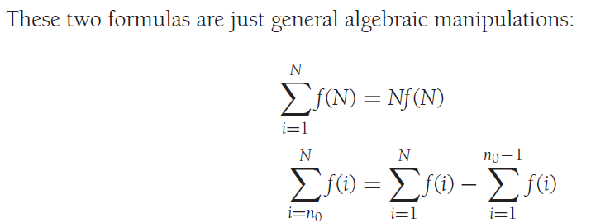
Series

Slide 33
Review of Concepts of ‘C++’
One-dimensional Array
Array
Multi-Dimensional Array
String Handling
User Defined Functions
Construction of a Function
Actual Argument and Formal Argument
Function
Call by Value and Call by Reference
Default Values for Parameters
Storage Class Specifiers

Slide 34
Review of Concepts of ‘C++’
Declaration of a Pointer
Initialization of a Pointer
Pointer
Arithmetic With Pointer
Passing of a Pointer to Function
Returning of a Pointer by Function
C++ Null Pointer
Structure
The typedef Keyword
Union

Slide 35

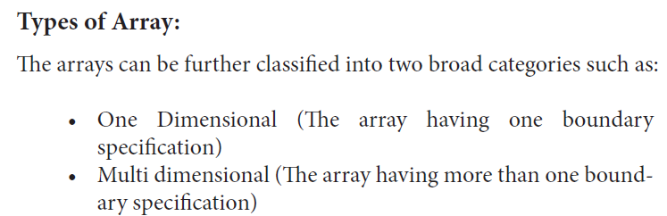
Array

Slide 36
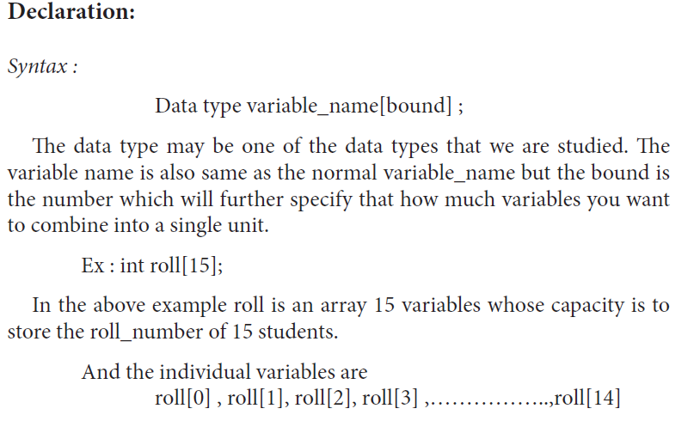
One-Dimensional Array

Slide 37
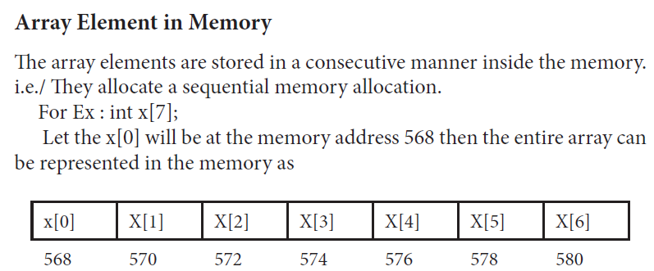
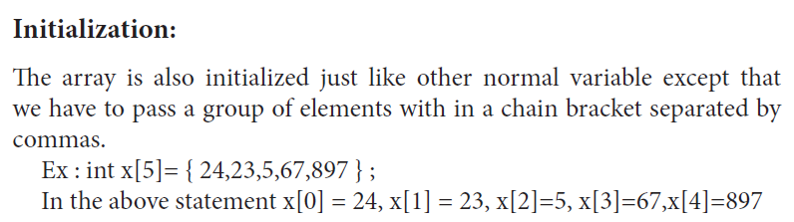
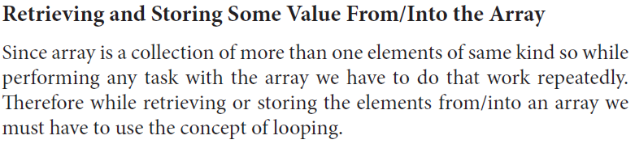
One-Dimensional Array

Slide 38
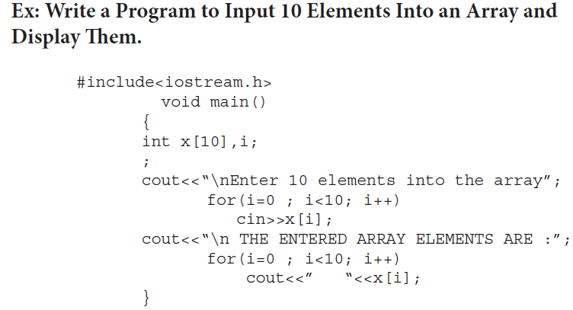
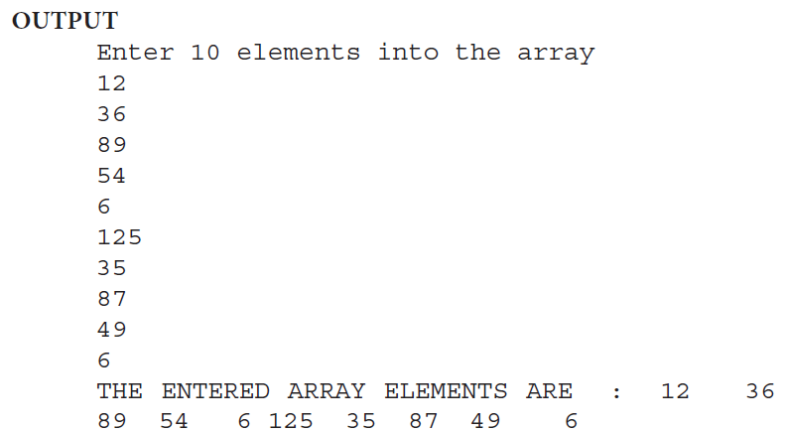
One-Dimensional Array

Slide 39
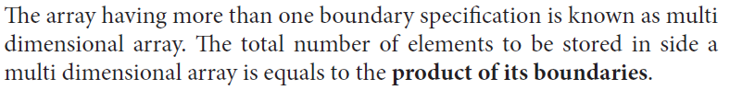
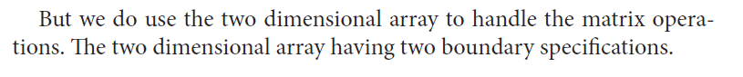
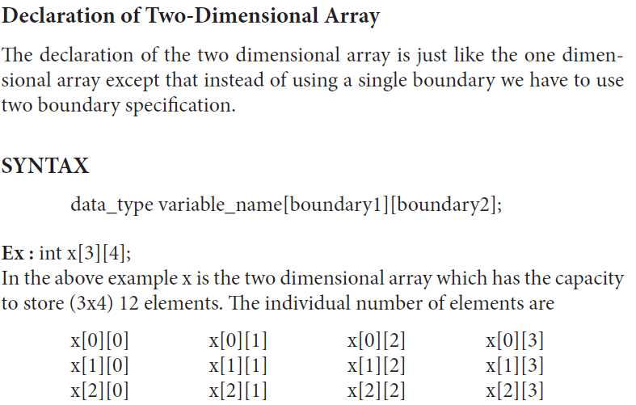
Multi-Dimensional Array

Slide 40
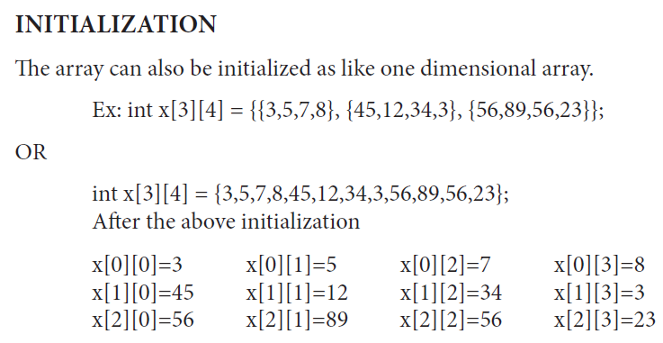
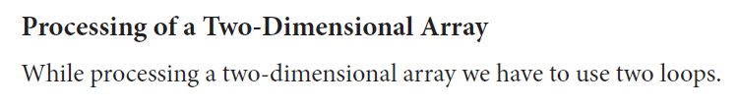
Two-Dimensional Array

Slide 41
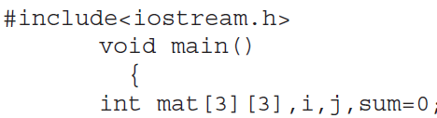
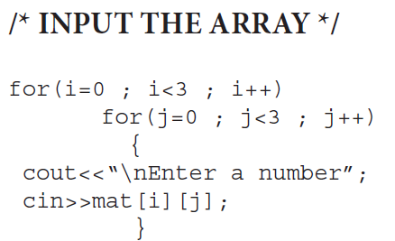
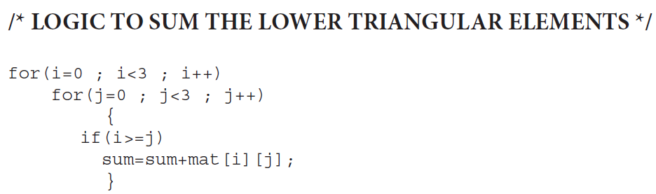
Example : WAP to input a 3 x 3 matrix and find out the sum of lower triangular elements.

Slide 42
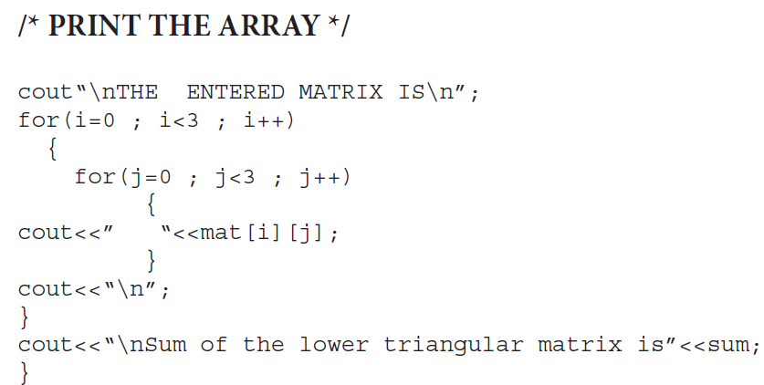
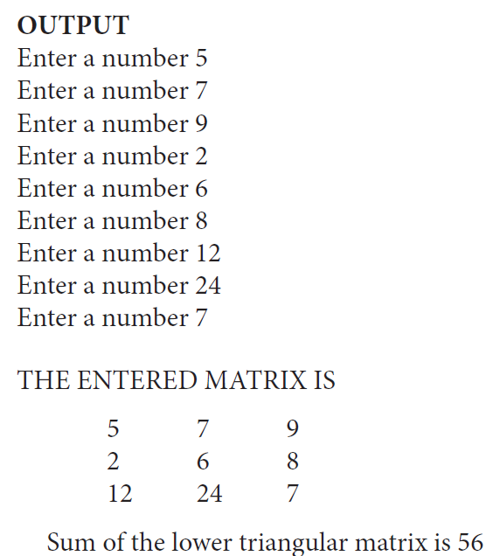
Example : WAP to input a 3 x 3 matrix and find out the sum of lower triangular elements.

Slide 43
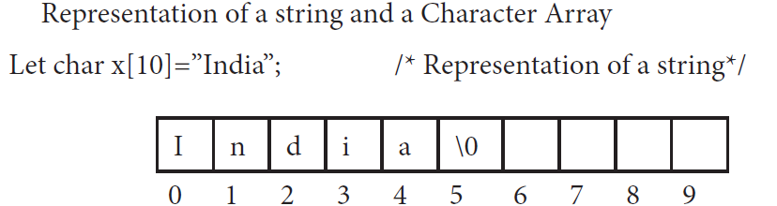
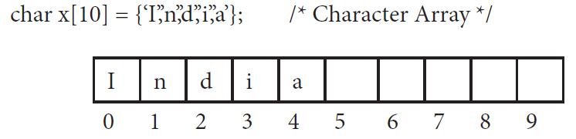
String Handling
The string is a collection of more than one character. So, it can also be called as a character array.
The string always terminates with a NULL (‘\0’) character.
If we want to convert the character array to a string so we have to assign the NULL character at the end of it, manually.

Slide 44
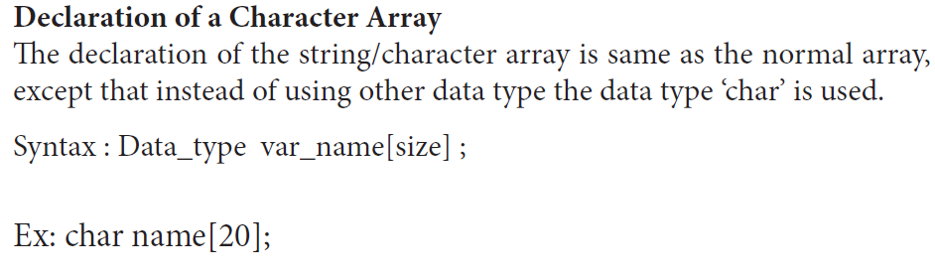



String Handling

Slide 45






String Handling

Slide 46


String Manipulation

Slide 47






String Manipulation

Slide 48





String Manipulation
Example
Output

Slide 49

Function

Slide 50


User Defined Functions
The functions can be categorized into four types as
Parts of a Function

Slide 51




Examples

Slide 52



Examples

Slide 53


Examples

Slide 54

Actual Argument and Formal Argument
Those arguments kept inside the function call is known as actual argument and those arguments kept inside the function definition is known as the formal arguments.

Slide 55

Call by Value and Call by Reference

Slide 56

Call by Value

Slide 57
#include <iostream>
void incrementByReference(int &num)
{
num++; // Modifies the original variable ‘a’
}
int main()
{
int a = 5;
std::cout << "Before call by reference: " << a << std::endl; // Output: 5
incrementByReference(a);
std::cout << "After call by reference: " << a << std::endl; // Output: 6
return 0;
}
#include <iostream>
void incrementByPointer(int *ptr) {
(*ptr)++; // Dereferences the pointer to modify the value at the address
}
int main() {
int b = 10;
std::cout << "Before call by pointer: " << b << std::endl; // Output: 10
incrementByPointer(&b); // Pass the address of 'b'
std::cout << "After call by pointer: " << b << std::endl; // Output: 11
return 0;
}

Slide 58
// C++ program to swap two numbers using
// pass by reference
#include <iostream>
using namespace std;
void swap(int& x, int& y)
{
int z = x;
x = y;
y = z;
}
int main()
{
int a = 45, b = 35;
cout << "Before Swap\n";
cout << "a = " << a << " b = " << b << "\n";
swap(a, b);
cout << "After Swap with pass by reference\n";
cout << "a = " << a << " b = " << b << "\n";
}
// C++ program to swap two numbers using
// pass by pointer
#include <iostream>
using namespace std;
void swap(int *x, int *y)
{
int z = *x;
*x = *y;
*y = z;
}
// Driver Code
int main()
{
int a = 45, b = 35;
cout << "Before Swap\n";
cout << "a = " << a << " b = " << b << "\n";
swap(&a, &b);
cout << "After Swap with pass by pointer\n";
cout << "a = " << a << " b = " << b << "\n";
}

Slide 59


Default Values for Parameters
When you define a function, you can specify a default value for each of the last parameters. This value will be used if the corresponding argument is left blank when calling to the function.

Slide 60


Storage Class Specifiers
The storage class specifiers are the keywords which are used to declare the variables.
Without the help of storage class specifier, we cannot declare the variables but till now we declare the variables without using the storage class specifier. Because by default the c-language includes the variable into ‘auto’ storage class.
‘C++’-language supports four storage class specifiers as auto, static, extern, register

Slide 61


Storage Class Specifiers

Slide 62


Difference between STATIC and AUTO

Slide 63
Assignment 1:
Explain the differences between storage class specifiers in C++ with suitable examples.

Slide 64
Pointer
The pointer is a variable which can store the address of another variable.
Declaration of a Pointer
Like other variables the pointer variable should also be declared before its Use
SYNTAX
Data_type *variable_name;
Example: int *p;
Initialization of a Pointer
Initialization means to assign an initial value, since the pointer can store only the address so during its initialization we have to assign an address of another variable.
Ex: int *x,p;
X=&p; /* INITIALIZATION */

Slide 65

Pointer
#include <iostream>
using namespace std;
int main() {
int var = 5;
// store address of var
int* point_var = &var;
// print value of var
cout << "var = " << var << endl;
// print address of var
cout << "Address of var (&var) = " << &var << endl << endl;
// print pointer point_var
cout << "point_var = " << point_var << endl;
// print the content of the address point_var points to
cout << "Content of the address pointed to by point_var (*point_var) = " << *point_var << endl;
return 0;
}

Slide 66

Arithmetic With Pointer
In general, the arithmetic operations include Addition, Subtraction, Multiplication, and Division.
But in case of pointer, we can perform only the addition and subtraction operations.
That means when we perform an addition/subtraction operation with the pointer then it shifts the locations because pointer means an address.
If we add one to the integer pointer then it will shift two bytes (int occupies two bytes in memory), so for float 4 bytes, char 1 byte, long double 4 bytes and accordingly it will shift the positions.
NOTE : Pointer means the address so we can perform any type of operation with *p (value at address)

Slide 67



Passing of a Pointer to Function

Slide 68



Returning of a Pointer by Function

Slide 69


C++ Null Pointer
It is always a good practice to assign the pointer NULL to a pointer variable in case you do not have exact address to be assigned.
This is done at the time of variable declaration.
A pointer that is assigned NULL is called a null pointer.
The NULL pointer is a constant with a value of zero defined in several standard libraries, including iostream.

Slide 70


Structure
A structure is a collection of data items(fields) or variables of different data types that is referenced under the same name. It provides convenient means of keeping related information together.
Example
Over all struct emp is a user defined data type.
So, to use the members of this structure we must have to declare the variable of struct emp type and the structure variable declaration is as same as the normal variable declaration which takes the form as
struct tag_name variable_name;
Ex : struct emp e;
To access name, age, and salary, the variable will be e.name, e.age, e.salary

Slide 71


Structure

Slide 72




Structure

Slide 73



The typedef Keyword

Slide 74
UNION
The UNION is also a user defined data type just like the structure, which can store more than one element of different data types.
All the operations are same as the structure.
The only difference between the structure and union is based upon the memory management i.e/ the structure data type will occupies the sum of total number of bytes occupied by its individual data members where as in case of union it will occupy the highest number of byte occupied by its data members.

Slide 75
Example: Write a program to demonstrate the difference between the structure and Union.
#include<iostream.h>
struct std
{
char name[20],add[30];
int roll, total;
float avg;
};
union std1
{
char name[20],add[30];
int roll, total;
float avg;
};
void main()
{
struct std s;
union std1 s1;
cout<<”\nThe no.of bytes occupied by the structure is”<<sizeof(struct std)); // 58
cout<<”\nThe no.of bytes occupied by the union is”<<sizeof(union std1)); // 30
}

Slide 76


